Slide 1
LIFE OF HOLY PROPHET ﷺ
NEED AND SIGNIFICANCE

Slide 2
LIFE OF HOLY PROPHET MUHAMMAD ﷺ
The word seerah (سیرۃ) is used for the biography of Holy Prophet ﷺ
Literal Meaning of Seerah
Seerah came from سَارَ, which means to travel or to be on a journey (Journey through life).
Seerah means the way of journey. سیرۃ النبی the way of life, the life style of Holy Prophet ﷺ

Slide 3
LIFE OF HOLY PROPHET MUHAMMAD ﷺ
Importance of Seerah in the Holy Qur’an
قُلْ إِن كُنتُمْ تُحِبُّونَ ٱللَّهَ فَٱتَّبِعُونِى يُحْبِبْكُمُ ٱللَّهُ وَيَغْفِرْ لَكُمْ ذُنُوبَكُمْ
Say, [O Muhammad], "If you should love Allah, then follow me,
[so] Allah will love you and forgive you your sins.
And Allah is Forgiving and Merciful."
وأَطِيعُوا اللَّهَ وَالرَّسُولَ لَعَلَّكُمْ تُرْحَمُونَ
And obey Allah and the Messenger that you may obtain mercy.

Slide 4
LIFE OF HOLY PROPHET MUHAMMAD ﷺ
Importance of Seerah in Hadees
مَنْ أَطَاعَنِي فَقَدْ أَطَاعَ اللَّهَ وَمَنْ عَصَانِي فَقَدْ عَصَى اللَّهَ
Whoever obeys me, obeys Allah, And whoever disobeys me, disobeys Allah.
تَرَكْتُ فِيكُمْ أَمْرَيْنِ لَنْ تَضِلُّوا مَا تَمَسَّكْتُمْ بِهِمَا كِتَابَ اللَّهِ وَسُنَّةَ نَبِيِّهِ
I have left two matters with you. As long as you hold to them,
you will not go the wrong way. They are the Book of Allah and
the Sunna of His Prophet.

Slide 5
LIFE OF HOLY PROPHET ﷺ Migration to Madina
Madinah (Strong Defensive Position)
Madina was chosen as the next place because its three corners were mountains while the one remaining fourth corner was desert.
Need of a Missionary Teacher
Holy Prophet ﷺ was asked a teacher by new Muslims. He sent Musaab bin Umair رضی اللہ عنہ
Plotting an assassination of Prophet by Non Believers
Nonbelievers planned in Dar u Nadwa to kill the Prophet in his house and surrounded his house

Slide 6
LIFE OF HOLY PROPHET ﷺ Migration to Madina
Sadiq & Amin
Many people deposited their valuable thing with Propher because of his truthfulness and trustworthiness, he entrusted all thing to Hazrat Ali
Jabl-e-Saur
Holy Prophet took Abu Baker from his home and proceed towards Jabl-e-Saur
Kuffar’s Curiosity
Nonbelievers followed the footprints and reached the cave. Holy Prophet said: Don’t worry Abu Bakar, Allah is with us.

Slide 7
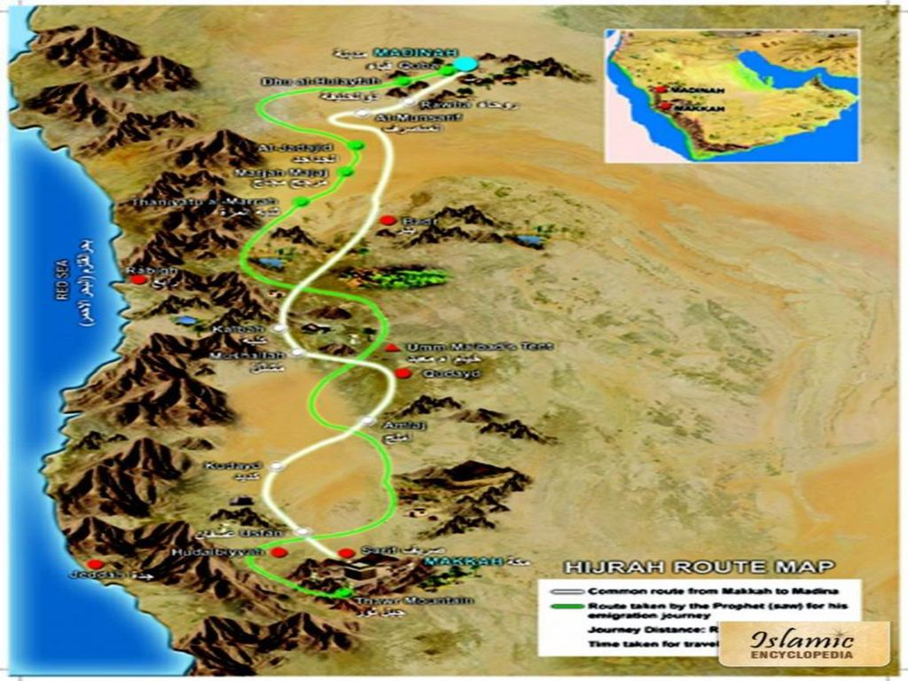
Hijrah Route

Slide 8
LIFE OF HOLY PROPHET ﷺ Migration to Madina
The way to Madina
On one camel were Amir bin Fuhaira (Abu Bakar’s slave) and Abullah bin Oryiqit (guidance) and on the other camel were Abu Bakar with Holy Prophet ﷺ.
Suraqa bin Jasham (سُراقۃ بن جعشم)
Nonbelievers had accounced reward against the Prophet. Suraqa was told by anyone the way of two companions. He found them. The Holy Prophet PBUH asked Allah Almighty for his mercy from Suraqa. Suddenly he got stucked till his bally in the ground by the order of Allah Almighty. He cried and asked mercy. The Holy Prophet condoned him.

Slide 9
LIFE OF HOLY PROPHET ﷺ Migration to Madina
Quba
Well-known tribe situated at southern corner of Madina. Holy Prophet ﷺ arrived on 8th of Rabi ul Awwal, 19th of September 622 and stayed in Quba fourteen days and constructed the first mosque of Islam named by Masjid-e-Quba.
The first Jumma of Islam
The next stop after Qub is Muhallah bni Sulaim. Prophet gave khutba and performed Jumma prayer in Muhallah bni Sulaim.

Slide 10
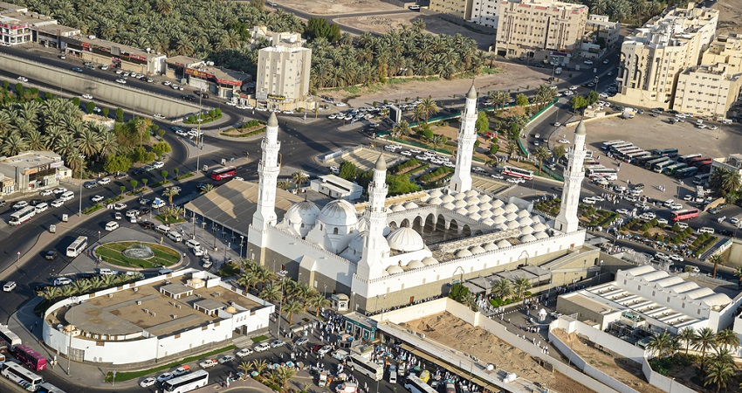

Slide 11
LIFE OF HOLY PROPHET ﷺ Final Destination Of Migration
After Jumma prater Holy Prophet entered in Madina from southern side
Ansaar of Madina were standing on both side of the entrance to welcome and singing the welcome song
طلع البدر علینا من ثنیاّت الوداع
The moon is raised on us from the passes of Wida
وجب الشکر علینا ما دعیٰ للہ داع
We have to thank Allah as long as the supplicant is pray

Slide 12
LIFE OF HOLY PROPHET ﷺ Final Destination Of Migration
The girls of Banu Najjar (mother’s relative) were singing the welcome song
نحن جوار من بنی نجّار
We are from Bni Najjar
یا حبّذا محمدا من جار
Definitely Muhammad is a best neighbor
Holy Prophet said ‘Leave her (camel) on her own, as she knows the will of Allah and Allah’s Prophet ﷺ. The camel stopped and sat down in front of Abu Auyb Ansaari’s house. Prophet smiled and stayed here nine months. This was the place where now is Masjid-e-Nabawi.

Slide 13
LIFE OF HOLY PROPHET ﷺ In Madinah
Holy Prophet created brotherhood between Muhajirin and Ansaar
Islam is a religion of brotherhood. Allah says
انما المؤمنون اخوۃ
In an other place says
وَأَلَّفَ بَيۡنَ قُلُوبِهِمۡۚ لَوۡ أَنفَقۡتَ مَا فِي ٱلۡأَرۡضِ جَمِيعا مَّآ أَلَّفۡتَ بَيۡنَ قُلُوبِهِمۡ وَلَٰكِنَّ ٱللَّهَ أَلَّفَ بَيۡنَهُمۡۚ
And he has united their hearts. If you had spent all that is in the earth,
you could not have united their hearts.

Slide 14
LIFE OF HOLY PROPHET ﷺ In Madinah
Number of groups in Madina at the time of Migration
Ansaars (انصار)
Ous (اوس)
Khazraj (خزرج)
Muhajirin
Jews
Banu Nazeer (بنو نظیر)
Banu Qenuqa (بنو قینقاع)
Banu Quraizah (بنو قریظہ)

Slide 15
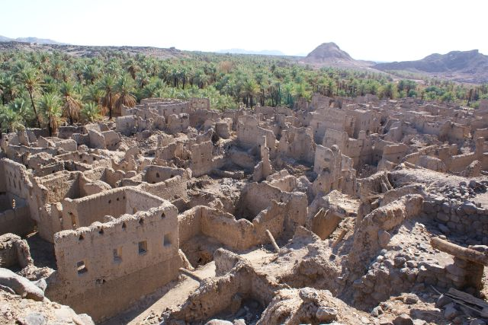
Bnu Quraiza’s Riuns

Slide 16
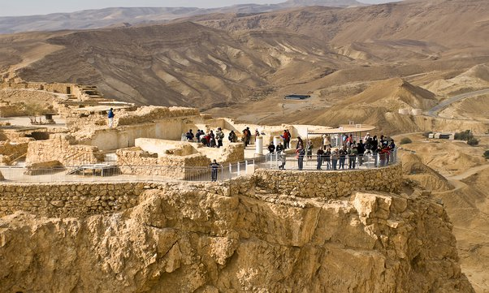
Bnu Quraiza’s Riuns

Slide 17
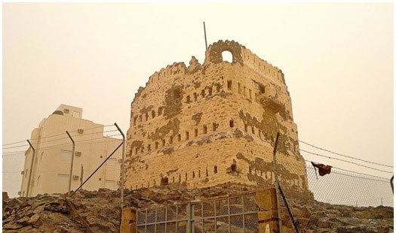
Bnu Nazeer’s Fort

Slide 18
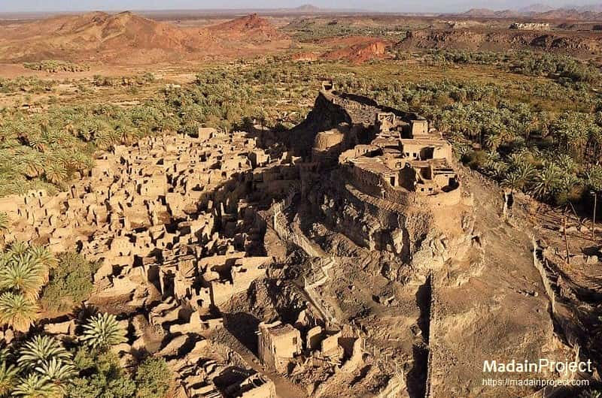
Khayber’s Fort

Slide 19
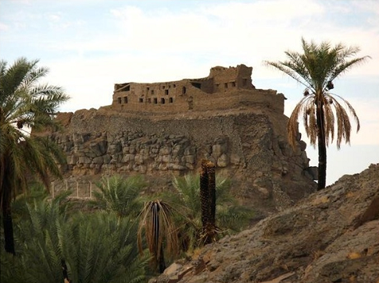
Khayber’s Fort

Slide 20
LIFE OF HOLY PROPHET ﷺ In Madinah Sulah Hudaibya
Holy Prophet ﷺ dreamed to do Umrah in 6th year of hijrah and informed his companions.
Holy Prophet ﷺ left Madina with fourteen hundred companions for going to Makkah
Polytheist got news, gathered army and appointed them on different entrance of Makkah
Budail Bin Warqa Khuzaie بُدیل بن ورقاء خزاعی (ally of Muslims) as a ambassador of Prophet

Slide 21
LIFE OF HOLY PROPHET ﷺ In Madinah Sulah Hudaibya
Urwa bin Masood Saqafi (عروۃ بن مسعود ثقفی) as ambassador of Polytheist
Usman bin Affan as ambassador of Prophet ﷺ. Rumors of his assassination
Bait-e-Rizwan
Suhail bin Amr as ambassador of Polytheist. When the prophet saw him made a good fortune from his name.
Ali has wrote the treaty

Slide 22
LIFE OF HOLY PROPHET ﷺ In Madinah Sulah Hudaibya
There should be peace between the Muslims and the Quraish for a period of 10 years.
The Muslims will return to Madinah without performing Umrah this year.
The Muslims should be able to perform Umrah next year with a stay of three days in Makkah.
The Muslims will only be armed with Swords and those swords will be hidden underneath sheaths.
If a person migrates to Madina, he will be returned. If a person migrates to Makkah, he will not be returned.
Tribes of Arabia are free to take any side they want.

Slide 23
LIFE OF HOLY PROPHET ﷺ In Madinah Sulah Hudaibya
Significance of the Treaty
The peace of Hudaybiyah proved to be a precursor to the conquest of Makkah. Holy Prophet PBUH was reciting Surah Al-Fatah while entering in Makkah.
Owing to the agreement, the hostile Quraish tribe recognized Prophet Muhammad (PBUH) as the leader of the state of Madinah.
Since followers of Islam and the polytheists were no longer in an ongoing struggle, some people started seeing the religion in a new light and became its followers.
After the agreement, Muslims were allowed to make alliances with other tribes.
The 10-year armistice gave Muslims a chance to preach Islam and deal with the enemies on the other side of the peninsula.

Slide 24
LIFE OF HOLY PROPHET ﷺ In Madinah Hajjat ul wada
In 10th year of hijra the Holy Prophet went to perform Hajj
One hundred thousand people joined in the pilgrimage the year

Slide 25
LIFE OF HOLY PROPHET ﷺ In Madinah Hajjat ul wada
O People Lend me an attentive ear, for I know not whether after this year, I shall ever be amongst you again. Therefor listen to what I am saying to you very carefully and take these words to those who could not be present here today.
O People Just as you regard this month, this day, this city as sacred, so regard the life and property of every Muslim as a sacred trust. Return the goods entrusted to you to their rightful owners. Hurt no one so that no one may hurt you. Remember that you will indeed meet your Lord, and that He will indeed reckon your deeds. Allah has forbidden you to take usury (interest); therefore all interest obligation shall henceforth be waived. Your capital, however, is yours to keep. You will neither inflict nor suffer any inequity.

Slide 26
LIFE OF HOLY PROPHET ﷺ In Madinah Hajjat ul wada
Allah has Judged that there shall be no interest and that all interest due to Abbas Ibn ‘Abd al Muttalib (the Prophet's uncle) shall henceforth be waived.
Beware of Satan for the safety of your religion. He has lost all hope that he will ever be able to lead you astray in big things, so beware of following him in small things.
O People It is true that you have certain rights in regard to your women, but they also have rights over you. Remember that you have taken them as your wives, only under Allah's trust and with His permission. If they abide by your right then to them belongs the right to be fed and clothed in kindness. Do treat you women well and be kind to them, for they are your partners and committed helpers. And it is your right that they do not make friends with anyone of whom you do not approve, as well as never to be unchaste.

Slide 27
LIFE OF HOLY PROPHET ﷺ In Madinah Hajjat ul wada
O People Listen to me in earnest, worship Allah, say your five daily prayers (Salah), fast during the month of Ramadan, and give your wealth in Zakat.
Perform Hajj if you can afford to.
All mankind is from Adam and Eve, an Arab has no superiority over a non-Arab nor a non-Arab has any superiority over an Arab; also a white has no superiority over a black, nor a black has any superiority over a white- except by piety and good action. Learn that every Muslim is a brother to every Muslim and that the Muslims constitute one brotherhood. Nothing shall be legitimate to a Muslim, which belongs to a fellow Muslim unless it was given freely and willingly. Do not therefor, do injustice to yourselves.

Slide 28
LIFE OF HOLY PROPHET ﷺ In Madinah Hajjat ul wada
Remember one day you will appear before Allah and answer for your deeds. So beware, do not stray from the path of righteousness after I am gone. People, no prophet or apostle will come after me and no new faith will be born. Reason well therefore, O people, and understand words which I convey to you. I leave behind me two things, the Quran and the Sunnah (Hadith), and if you follow these you will never go astray. All those who listen to me shall pass on my words to others and those to others again; and may the last ones understand my words better than those who listened to me directly. Be my witness, O Allah, that I have conveyed your message to your people."

Slide 29
LIFE OF HOLY PROPHET ﷺ Self Purification (تزکیہ) & Character Building
Self Purification (تزکیہ) meaning
Cleaning and purifying entire flow of actions from things which are unwholesome and unwelcome in eye of Allah. In other words Tazkiya mean developing of character, thought and behavior.

Slide 30
LIFE OF HOLY PROPHET ﷺ Self Purification (تزکیہ) & Character Building
Tazkiya in Quran
قَدْ أَفْلَحَ مَن زَكَّاهَا
He has succeeded who purifies it.
هُوَ الَّذِي بَعَثَ فِي الْأُمِّيِّينَ رَسُولًا مِّنْهُمْ يَتْلُو عَلَيْهِمْ آيَاتِهِ وَيُزَكِّيهِمْ
It is He who has sent among the unlettered a
Messenger from themselves reciting to them
His verses and purifying them.

Slide 31
LIFE OF HOLY PROPHET ﷺ Self Purification (تزکیہ) & Character Building
Tazkiya in Hadees
ألا وإن فى الجسد مضغة إذا صلحت صلح الجسد
كله، وإذا فسدت فسد الجسد كله‏:‏ ألا وهى القلب
Verily, there is a piece of flesh in the body, if it is healthy,
the whole body is healthy, and if it is corrupt, the whole
body is corrupt. Verily, it is the heart.

Slide 32
LIFE OF HOLY PROPHET ﷺ Self Purification (تزکیہ) & Character Building
Methodology of Prophet ﷺ (elements of Tazkiya)
Fearing Allah
يَا أَيُّهَا الَّذِينَ آمَنُوا اتَّقُوا اللَّهَ حَقَّ تُقَاتِهِ
O you who have believed, fear Allah as He should be feared
نحْنُ أَقْرَبُ إِلَيْهِ مِنْ حَبْلِ الْوَرِيدِ
We are closer to him than [his] jugular vein

Slide 33
LIFE OF HOLY PROPHET ﷺ Self Purification (تزکیہ) & Character Building
Methodology of Prophet ﷺ (elements of Tazkiya)
Fear of Hereafter
عن عائشة رضي الله عنها يُحْشَرُ الناس يوم القيامة حفاة عراة غُرْلًا قلت يا رسول الله
الرجال والنساء جميعا ينظر بعضهم إلى بعض؟ قال يا عائشة الأمر أشد من أن يهمهم ذلك۔
‘Ā'ishah, the Mother of the Believers, (may Allah be pleased with her) reported: I heard the Messenger of Allah (may Allah's peace and blessings be upon him) saying: "People will be gathered on the Day of Resurrection barefooted, naked, and uncircumcised. I said: 'O Messenger of Allah, men and women together, looking at each other? He replied: O ‘Ā'ishah, the situation will be too grave for them to be concerned with that.

Slide 34
LIFE OF HOLY PROPHET ﷺ Self Purification (تزکیہ) & Character Building
Methodology of Prophet ﷺ (elements of Tazkiya)
Self control
يَا أَيُّهَا الَّذِينَ آمَنُوا لَا تَتَّبِعُوا خُطُوَاتِ الشَّيْطَانِ
O you who believe! Follow not the footsteps of Shaitan (Satan).
Worship
وَمَا خَلَقْتُ الْجِنَّ وَالْإِنسَ إِلَّا لِيَعْبُدُونِ
And I (Allah) created not the jinns and humans except they should worship Me (Alone).

Slide 35
LIFE OF HOLY PROPHET ﷺ Self Purification (تزکیہ) & Character Building
Repentance
یا أَيُّهَا الَّذِينَ آمَنُوا تُوبُوا إِلَى اللَّهِ تَوْبَةً نَّصُوحًا
O you who believe! Turn to Allah with sincere repentance!
Self Accountability
الكيس من دان نفسه، وعمل لما بعد الموت ، والعاجز من أتبع نفسه هواها، وتمنى على الله
A wise man is the one who calls himself to account (and refrains from doing evil deeds) and does noble deeds to benefit him after death; and the foolish person is the one who subdues himself to his temptations and desires and seeks from Allah the fulfillment of his vain desires.

Slide 36
LIFE OF HOLY PROPHET ﷺ Self Purification (تزکیہ) & Character Building
Remembrance of Allah
الَّذِينَ آمَنُوا وَتَطْمَئِنُّ قُلُوبُهُم بِذِكْرِ اللَّهِ ۗ أَلَا بِذِكْرِ اللَّهِ تَطْمَئِنُّ الْقُلُوبُ
Those who believe in Allah and whose hearts find
rest in the remembrance of Allah, Verily, in the
remembrance of Allah do hearts find rest.
Good and Virtuous Company
یا أَيُّهَا الَّذِينَ آمَنُوا اتَّقُوا اللَّهَ وَكُونُوا مَعَ الصَّادِقِينَ
O you who believe! Be afraid of Allah, and be with those who are true.

Slide 37
LIFE OF HOLY PROPHET ﷺ Self Purification (تزکیہ) & Character Building
Moderation
وَكَذَٰلِكَ جَعَلۡنَٰكُمۡ أُمَّة وَسَطا
And in the same way we have made you moderate community.
قالَ رَسُولُ اللَّهِ صَلَّى اللَّهُ عَلَيْهِ وَسَلَّمَ أَحَبُّ الْأَعْمَالِ إِلَى الله أدومها وَإِن قل۔
The acts most pleasing to God are those which are done most continuously, even if they amount to little.

Slide 38
Asharah Mubasharah
Asharah Mubasharah mean ten companions whose are given the good news of Jannah by Holy Prophet ﷺ
ابو بکر فی الجنة و عمر فی الجنة وعثمان فی الجنة و علی فی الجنة
و طلحة فی الجنة و الزبیر فی الجنة و عبدالرحمن بن عوف فی الجنة
و سعد بن أبي وقاص فی الجنة و سعید بن زید فی الجنة و ابو عبیدة
بن الجراح فی الجنة

Slide 39
ازواجِ مطہرات Wives of Holy Prophet ﷺ
1- Khadijah bint Khuwaylid رضی اللہ عنہا
first wives.
married her when he was twenty-five years old, and she was 40 years old.
did not take another wife until she died.
All his children were born to her, except Ibrahim.
She passed away three years before hijra in year of grief (عام الحزن)
Aishah رضی اللہ عنہا who said: “I never felt jealous of any of the wives of the Prophet ﷺ as I did of Khadijah, although she died before he married me, because of what I heard him say about her

Slide 40
ازواجِ مطہرات Wives of Holy Prophet ﷺ
2-Sawdah bint Zam’a (b.unknown – d.674 CE)
Sawdah and her first husband early converted to Islam who immigrated to Abyssinia. Her husband passed away in exile and she was left a poor widow with small children.
Sawdah had the great honor of being an immigrant for the sake of Islam on two occasions, to Abyssinia and then to Medina.
She was the first of a number of widows the Prophet married.
Sawdah had a reputation for being a kind, charitable and jovial woman.

Slide 41
ازواجِ مطہرات Wives of Holy Prophet ﷺ
3 – Hazrat Aisha Bint Abu Bakr RA
The nearest and dearest to the Messenger of Allah. She was married, but since she was very young.
Very INTELLIGENT. The Messenger of Allah was often heard laughing in surprise at her quick wit.
AMAZING MEMORY. She was an expert in the interpretation of the Quran, hadith, and law.
HAFIZA and MUHADDITHA. She have narrated 2210 ahadith in her lifetime.
VERY GENEROUS
HONEST. She was nicknamed As-Siddiqa (The Truthful Woman).

Slide 42
ازواجِ مطہرات Wives of Holy Prophet ﷺ
4 – Hazrat Hafsah bint Umar ibn Al-Khattab رضی اللہ عنہما
She was twenty when she joined the rank of the wives of the Prophet of Allah.
THIRSTY FOR KNOWLEDGE HAFIDHA and was able to write and read the Holy Quran
Custodian of the first Mushaf
She was extremely PIOUS and spent her days fasting and nights in prayer.

Slide 43
ازواجِ مطہرات Wives of Holy Prophet ﷺ
5- Zaynab bint Khuzaymah (b.595 – d.624)
Zaynab was the first of Prophet Muhammad’s wives that did not come from the tribe of Quraish. She died less than one year after her. Before this marriage she had earned the title of Mother of the Poor due to her work with the poor and her generosity to them.
However her last husband died in battle and her marriage to Prophet Muhammad set a precedent for others to follow. Muslim men no longer feared that their deaths in battle would mean starvation and neglect for their families. It became honorable to marry the widows of the deceased.

Slide 44
ازواجِ مطہرات Wives of Holy Prophet ﷺ
6- Umm Salamah Hind bint Abu Umayyah (b.596 – d.680 CE)
Married at the age of twenty nine, former husband died in the battle of Uhud.
Her life was filled with examples of patience in the face of trials and tribulations.
Marriage to the Prophet of Allah answered that du’a. Umm Salamah narrated more than 300 hadiths, many of them concerning women. She accompanied the Prophet on many of his expeditions and was married to him for seven years until his death. Umm Salamah outlived all the other wives and died at the age of eighty four.

Slide 45
ازواجِ مطہرات Wives of Holy Prophet ﷺ
7- Juwayriyah bint al-Haarith (b.608 – d.673 CE)
captured in the battle against the tribe Banu Mustaliq. 20 years old daughter of the chief of Banu Mustaliq
Her marriage brought an alignment between her tribe and the Muslims
When Prophet Muhammad married Juwayriyah it allowed the tribe to enter Islam with honor by removing the humiliation of their defeat. As soon as the marriage was announced, all the war booty that had been taken from Banu Mustaliq was returned, and all the captives were set free.
Juwayriyah was married to the Prophet for six years, and lived for another thirty-nine years after his death. She died at the age of sixty-five.

Slide 46
ازواجِ مطہرات Wives of Holy Prophet ﷺ
8. Ramla bint Abu Sufyan (Um Habeebah)
Ramla bint Abu Sufyan had travelled with her husband to Abyssinia, but he became a Christian there or died.
Consequently, Ramla bint Abu Sufyan had the choice to return to her father, who was still fighting the Messenger (peace be upon him) at that time, or experience difficulties in holding on to her religion when her husband had left Islam. As a result, the Messenger (peace be upon him) married Ramla bint Abu Sufyan in order to protect her from these difficulties and to protect her from returning to polytheism. This marriage to one from the family of Abu Sufyan also softened Abu Sufyan’s heart.

Slide 47
ازواجِ مطہرات Wives of Holy Prophet ﷺ
9- Zaynab bint Jahsh (b.590 – d.641 CE)
A young girl from the noble line of Quraish was once married to Prophet Muhammad’s freed slave and adopted son Zayd.
Verses in the Quran were revealed to deal with this matter and by marrying Zaynab, Prophet Muhammad demonstrated that in Islam an adopted son is not the same as a natural son. Zaynab joined the growing family of Muhammad and was known for her generosity and charitable works. She died at the age of fifty.

Slide 48
ازواجِ مطہرات Wives of Holy Prophet ﷺ
10- Safiyyah bint Huyayy ibn Akhtab (b.610 – d.670 CE)
Safiyyah was born in Madinah to Huyayy ibn Akhtab, the chief of the Jewish tribe Banu Nadir. Banu Nadir had been expelled from Madinah and settled at Khaybar. In 629 CE, the Muslims were victorious at the Battle of Khaybar and Safiyyah was taken captive. Muhammad suggested that Safiyyah convert to Islam, she agreed, and become Muhammad’s wife.
Despite her conversion, Muhammad’s other wives teased Safiyyah about her Jewish origin. Prophet Muhammad once said to his wife:
“If they discriminate you again, tell them that your husband is Muhammad, your father was Prophet Aaron and your uncle was Prophet Musa. So what is there in that to be scornful about?”
Safiyyah was twenty-one years old when the Prophet died. She lived for another 39 years, passing away in Medina at the age of 60.

Slide 49
ازواجِ مطہرات Wives of Holy Prophet ﷺ
11- Maymunah bint al-Haarith (b.594 – d.674 CE)
Maymunah, or Barra as she was then called, yearned to marry the Prophet and offered herself to him in marriage. He accepted. Maymunah lived with the Prophet for just over three years, until his death. She was very good natured and her nephew, Ibn Abbas, who later became the greatest scholar of the Quran, learned much from her knowledge.

